Slide 1
Inside Reading 4 lesson 7 (second reading)
Written by: Keivan jamali
KPS

Slide 2
The Wisdom Of Crowds
One day in 1906, the British scientist Francis Gallon headed for a country fair in the town of Plymouth where the local farmers and townspeople gathered to appraise the quality of each other's cattle, sheep, chickens, and horses. Examining workhorses may seem a strange way for a scientist to spend an afternoon, but there was a certain logic to it. Gallon was a man obsessed with two things: the measurement of physical and mental qualities, and breeding. And livestock shows are all about good and bad breeding.(1-12)
Breeding mattered to Galton because he believed that only a very few people had the characteristics necessary to keep societies healthy. He had devoted much of his career to measuring those characteristics and developing statistical procedures and formulas for doing so. His experiments left him with little faith in the intelligence of the average person, "the stupidity and wrong headedness of many men and women being so great as to be scarcely credible." Only· if power and control stayed in the hands of the select, well bred few, Gallon believed, could a society remain healthy and strong.(13-25)
KPS

Slide 3
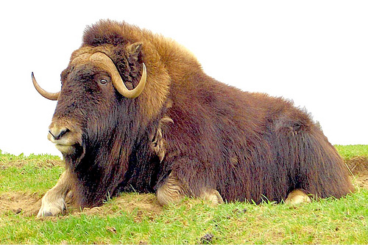
3. As he walked through the exhibition that day Galton came across a weight judging competition. A fat ox had been placed on display, and members of a gathering crowd were lining up to guess what the weight of the ox would be after it had been "slaughtered and dressed." Each guess was written on a numbered ticket. The best guesses would receive prizes.(26-33)
4. Eight hundred people made guesses. " Many non experts competed," Galton wrote later in the scientific journal Nature He described how clerks and others with no expert knowledge of horses try to judge which horses will win a race, "guided by newspapers, friends, and their own fancies." The analogy to a democracy, in which people of radically different abilities and interests each get one vote, had suggested itself to Galton immediately. "The average competitor was probably as well fitted for making a just estimate of the dressed weight of the ox, as an average voter is of judging the merits of most political issues on which he votes," he wrote.(34-47)
KPS

Slide 4
5. To test this hypothesis, Galton turned the competition into an impromptu experiment. When the contest was over, the organizers consented to give Gaitan all the tickets, and he ran a series of statistical tests on them. After excluding 13 tickets with illegible answers, Galton then added all the contestants' estimates and calculated the mean of the group’s guesses That number represented, you could say, the collective wisdom of the Plymouth crowd. If the crowd were a single person, that was how much it would have guessed the ox weighed.(48-59)
6. Gaitan undoubtedly thought that the average guess of the group would be way off the mark. But Galton was wrong. The crowd guessed that the ox would weigh 1,197 pounds. After it had been slaughtered and dressed, it weighed 1,198 pounds. In other words, the crowd's judgment was essentially perfect. Perhaps breeding did not mean so much after all. Gaitan wrote later: "The result seems more creditable to the trustworthiness of a democratic judgment than have been expected." That was, to say the least, an understatement.(60-71)
KPS

Slide 5
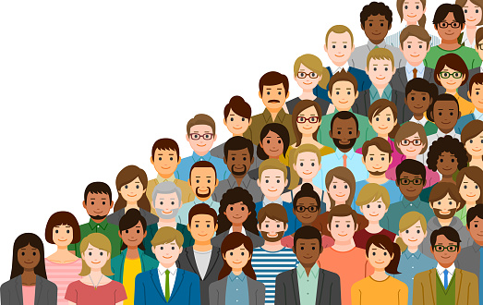
7. Francis Galton stumbled on a simple, but powerful, truth: under the right circumstances groups are remarkably intelligent, and are often smarter than the smartest people in them. Even if most of the people within a group are not especially well informed or rational, it can still reach a collectively wise decision. This is a good thing, since human beings are not perfectly designed decision makers. We generally have less information than we'd like. We have limited foresight into the future. Most of us lack the ability and the desire to make sophisticated cost benefit calculations Instead of insisting on finding the best possible decision, we will often accept one that seems good enough. And we often let emotion affect our judgment. Yet despite all these limitations, our collective intelligence, or what I'll call "the wisdom of crowds," is often excellent.(72-90)
KPS

Slide 6
8. Charles Mackay would have scoffed at the idea that a crowd of people could know anything at all. Mackay was the Scottish journalist who, in 1841, published Extraordinary Popular Delusions and the Madness of Crowds, an endlessly entertaining chronicle of mass manias and collective follies. Mackay's thesis was that crowds were never wise. They were never even reasonable. Collective judgments were doomed to be extreme. "Men, it has been well said, think in herds," he wrote. "It will be seen that they go mad in herds, while they only recover their senses slowly and one by one." Nonetheless, the wisdom of crowds has a far more important and beneficial impact on our everyday lives than we or Charles Mackay recognize, and its implications for the future are immense.(91-108)
9. One of the striking things about the wisdom of crowds is that even though its effects are all around us, it's easy to miss, and, even when it's seen, it can be hard to accept. Most of us, whether as voters or investors or consumers or managers, believe that valuable knowledge is concentrated in a very few hands. We assume that the key to solving problems or making good decisions is finding that one right person who will have the answer. Even when we see a large crowd of people, many of them not especially well informed, do something amazing like, say, predict the outcomes of horse races, we are more likely to attribute that success to a few smart people in the crowd than to the crowd itself. As sociologists Jack R. Soil and Richard Larrick put it, we feel the need to "chase the expert ." Chasing the expert is a mistake, and a costly one at that. We should stop hunting and ask the crowd instead. Chances are, it knows.(109-128)
KPS

Slide 7
10. Mackay was right about the extremes of collective behavior: there are times think of a riot, or a stock market bubble when collective decisions are utterly irrational. And in the present, many groups struggle to make even mediocre decisions, while others wreak havoc with their bad judgment. The fact is, groups work well under certain circumstances, and less well under others. Groups generally need to enforce rules to maintain order and coherence, and when they're missing or malfunctioning, the result is trouble. Groups benefit from members talking to and learning from each other, but too much communication, paradoxically , can actually make the group as a whole less intelligent. While big groups are often good for solving certain kinds of problems, big groups can also be unmanageable and inefficient.(129-149)
11. Conversely, small groups are easy to run, but they risk having too little diversity of thought and too much consensus. Diversity and independence are important because the best collective decisions are the product of disagreement and contest, not consensus or compromise. An intelligent group does not ask its members to conform to its positions in order to let the group reach a decision everyone can be happy with. Instead, it figures out how to use mechanisms like market prices, or intelligent voting systems to produce collective judgments that represent not what any one person in the group thinks but rather, in some sense, what they all think. Paradoxically, the best way for a group to be smart is for each person in it to think and act as independently as possible.(150-164)
KPS

Slide 8
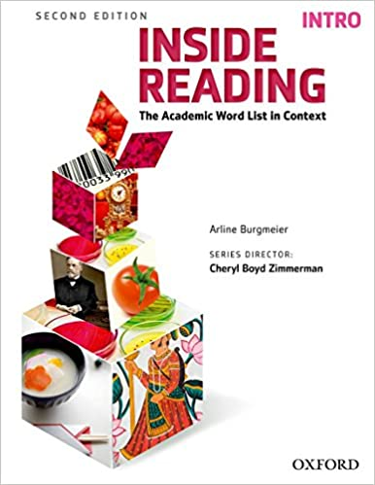
Now what’s your opinion???
Thank you for using my power point, hope you like it. Don’t forget to leave subscribe on our page☺.
My page address : coming soon
Our website : coming late
KPS

